Slide 1

Automated Service Ticket Resolution
MAJOR Project
Under The Guidance:
Mr. V. Venkataiah
Akkineni Maneesh Sai Swaroop (16H51A0563)
Mohd Luqmanuddin Siddiqui(16H51A0593)
Nellutla Koundinya(16H51A05G0)

Slide 2
Objective
To provide Ticket resolution efficiently using Priority algorithm and automate the ticket assignment to the respective engineer.
Scope
This application provides ticket resolution and hence can be used for companies, organisations, universities, etc. looking for such service oriented software.

Slide 3
ABSTRACT
This System deals with tickets raised by the user which can be resolved by the respective service engineer. It has 3 users- Admin, Service Engineer and End user. Admin can add or remove users.
User can raise a ticket upon which the system would automatically look for a service engineer who is not assigned any tickets currently or if there is no free service engineer, it will be assigned to the one who is working on the most recently raised low priority ticket. The status of the tickets will be changed automatically as tickets keep getting resolved. The ticket assigning is done using Priority algorithm.

Slide 4
Existing System
The ticket assigning was left to the Service Engineers and they had to assign the tickets to themselves(manually) as they want which is not very efficient and leaves a huge burden on Service engineers.
Users cannot track their ticket status, have to wait till a notification is sent that it is resolved.
Service Engineers cannot track their performance, as in the average time taken to resolve a ticket.
The web application uses XML configuration which does not support cross-platform well.
Uses SOAP services which is not as good as REST services.

Slide 5
Proposed System
The ticket assignment is automated and maintained by the system rather than leaving it to the individuals which is more efficient and reduces burden on the service engineers.
Users can track their tickets status from time to time.
Service Engineers can track their performance and also the performance of other individuals and the organization as the whole.
The web application here uses JSON configuration which is supported in all browsers and platforms.
Here REST services are used which creates more loose coupling and can be used directly in any type of applications, i.e., consuming them.

Slide 6
Advantages
User friendly interface.
Reduces human effort.
User can track the status of their tickets.
Saves a lot of time and paper work.
Transparency in service.
Cross-platform support

Slide 7
Role
ADMIN
Admin can add End-users, Service Engineer or other Admin
Admin can add a department to the list of existing departments.
Admin can view / delete End-users and Service Engineers (only when the Service Engineer is free).

Slide 8
Role
SERVICE ENGINEER:
The Service-Engineer is responsible for managing the tickets assigned to him in respective department.
He / She is capable of viewing and responding to his tickets. He need not worry about changing the status of the ticket according to the priority of the tickets assigned to him but the process is automated which is more efficient and provides ease to the Service Engineer.
He / She can view report statistics of tickets being resolved i.e. the avg. time taken to resolve a ticket of particular priority, and also view the report statistics of every Service Engineer i.e. Avg. time taken by each Service Engineer to resolve a ticket.
He / She can also view the age of his open tickets. i.e. the time or duration of an open(unresolved) ticket since its birth time till current date.

Slide 9
Role
END-USER:
End-User can raise a ticket for any query in any department required by him. And a ticket will be raised and assigned to the service engineer of that particular department.
End-User can also view tickets raised by him/her.

Slide 10
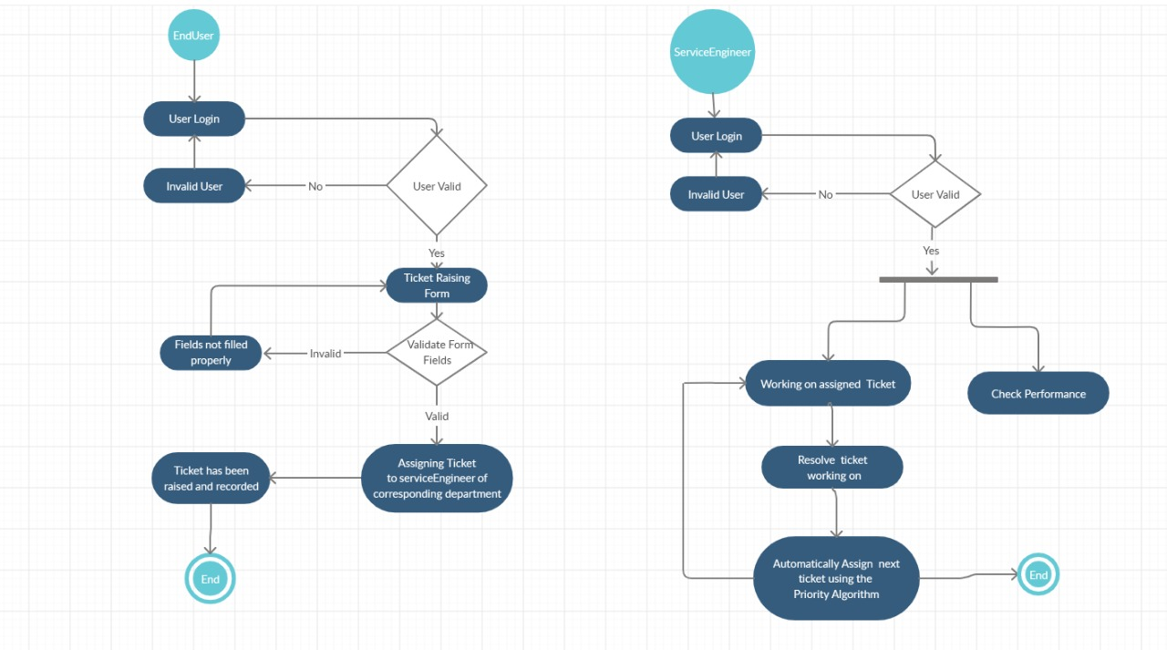
Architecture

Slide 11
Technologies Used
Operating System : Windows XP and later
Front-End: Angular, Bootstrap
Programming Language : Java 8
Framework: Spring Boot
Database : My SQL6

Slide 12
Conclusion
By using this application, the ticket assignment to the service engineer has been automated increasing the efficiency.
Also the ticket assignment uses Priority algorithm which was lacking in the existing system.
User friendly interface has been provided to the user enabling him to track his tickets easily.

Slide 13
Thank You!!!

